Slide 1
Software Evolution
Static Code Analysis – Linting & Refactoring

Slide 2
What’s Linting
Linting is the automated checking of your source code for programmatic and stylistic errors. This is done by using a lint tool (otherwise known as linter). A lint tool is a basic static code analyzer.

Slide 3
Motivation
Linting is important to reduce errors and improve the overall quality of your code. Using lint tools can help you accelerate development and reduce costs by finding errors earlier.

Slide 4
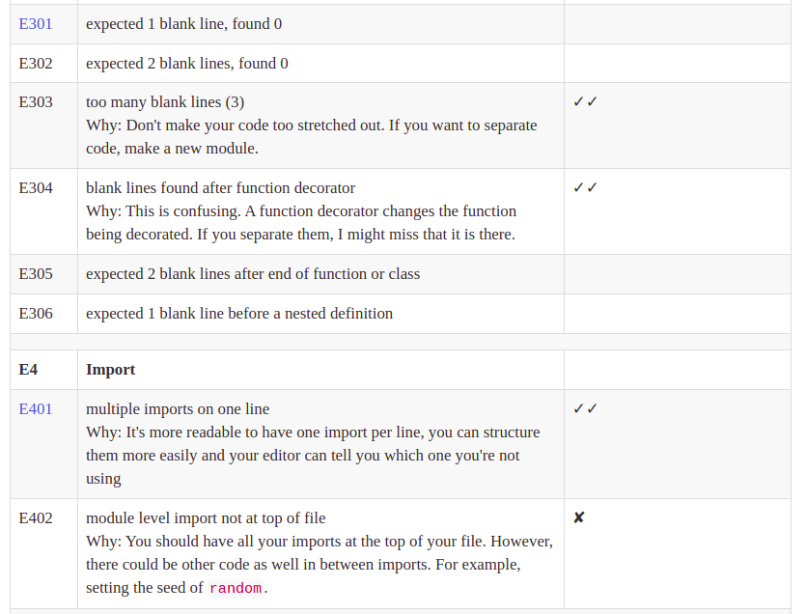
Examples (Linting Rules)

Slide 5
Tools (Python)
Flake8 (Check code against linting Rules)
Yapf (Format and Refactoring tool, based on the linting rules)

Slide 6
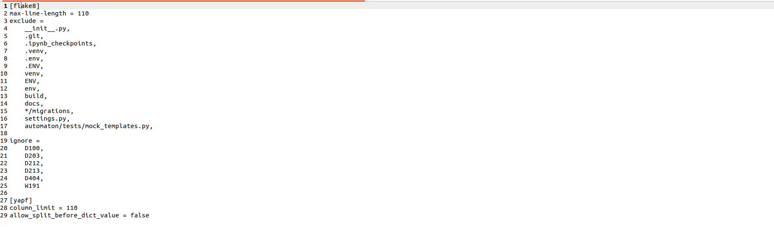
Examples (Setup)

Slide 7
Automated Linting
We can integrate Linting checker with github so any CI tool can review any new pull requests given the linting rules.
Topic To Discuss, what’s CI ?

Slide 8
Questions

